Slide 1



SMART INDIA HACKATHON 2025
Problem Statement ID –25048
Problem Statement Title- Gamified Learning Platform for Rural Education
Theme-Smart Education
PS Category- Software
Team ID-
Team Name - PLAY 2 PROGRESS
@SIH Idea submission
1

Slide 2

ABSTRACT
PLAY 2 PROGRESS
This project presents a game-based STEM learning platform that makes education engaging and interactive through quizzes, challenges, and rewards.
It supports multiple regional languages for inclusivity and is simple, user-friendly, and adaptable to various curricula.
Teachers can use it to enhance classroom learning, while students gain curiosity, active participation, and stronger conceptual understanding.
The platform bridges learning gaps and empowers rural students with 21st-century digital tools.
@SIH Idea submission
2

Slide 3
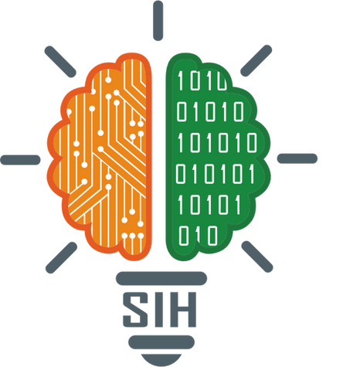
PLAY 2 PROGRESS
WHAT IS THE PROBLEM?
STEM subjects are often seen as boring and difficult, especially in rural schools where language barriers, costly apps, poor internet access, and lack of curriculum focus limit learning. Teachers lack tools to track progress, leading to low engagement, weak conceptual understanding, and fewer career opportunities in science and technology.
EXISTING SOLUTIONS:
Byju’s / Vedantu / Toppr → Offer digital learning but are mostly in English/Hindi and need paid subscriptions.
Kahoot / Quizizz → Fun quiz-based platforms but not structured for full STEM curriculum.
DIKSHA App (Govt. of India) → Provides free e-content in some regional languages, but lacks gamification and engagement features.
But none of the existing solutions successfully combine STEM-focused content with gamified learning, regional language inclusivity, and dedicated teacher support
@SIH Idea submission
3

Slide 4
Gamified Learning Platform for Rural Education
PLAY 2 PROGRESS
Proposed Solution:
A game-based learning web platform that makes STEM subjects fun, engaging, and inclusive for students.
It integrates gamification (levels, badges, rewards) with regional language support and provides teacher dashboards to track progress.
@SIH Idea submission
4

Slide 5


PLAY 2 PROGRESS
KEY FEATURES
1
🎮 Gamified Learning – Quizzes, challenges, levels, badges, and rewards to make STEM fun.
🌍 Regional Language Support – Students learn in their preferred language.
📊 Teacher Dashboard – Track progress, identify weak areas, and give targeted support.
📚 Curriculum-Aligned – Designed specifically for STEM subjects.
💻 Simple & Scalable – Easy to use, can expand to more schools and subjects.
2
3
4
5
@SIH Idea submission
5

Slide 6







TECHNICAL APPROACH
PLAY 2 PROGRESS
FRONTEND:
HTML, CSS, JavaScript – to build a simple, interactive web interface
BACKEND:
PHP / Python (Flask/Django) – to handle authentication, game logic, and APIs
DATABASE:
MySQL / SQLite – to store student progress, questions, and results
OTHER TOOLS & SERVICES:
PWA (Progressive Web App) , XAMPP/WAMP,GoogleTranslate API / i18n libraries,Gamification Logic
@SIH Idea submission
6

Slide 7
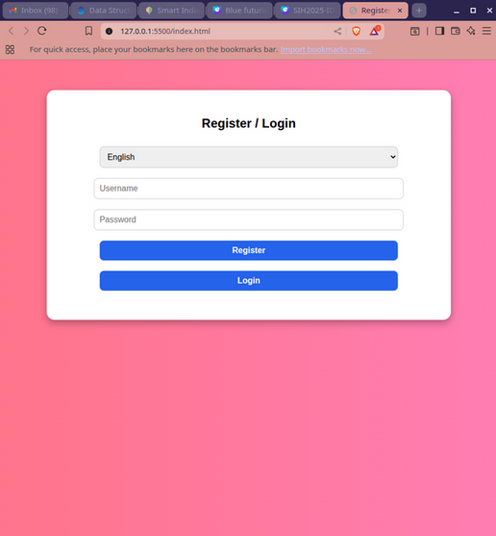
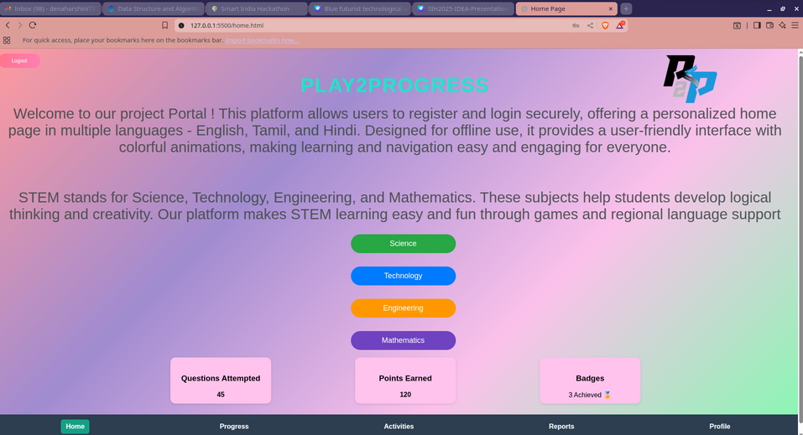
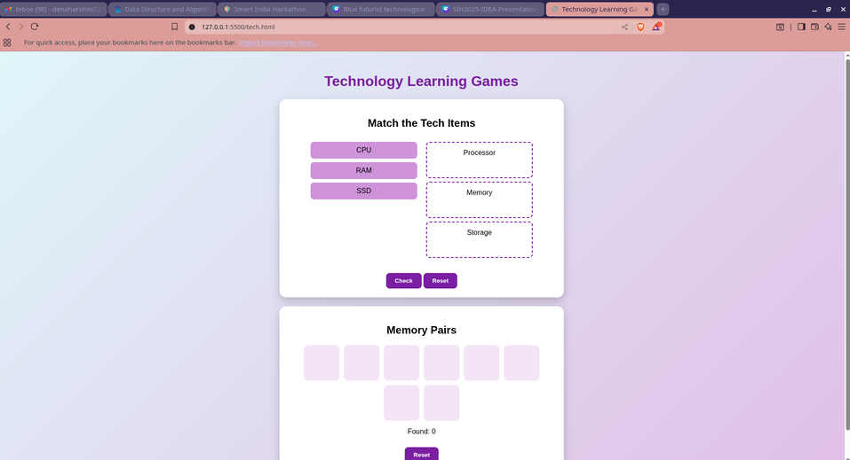
RESEARCH AND REFERENCES
PLAY 2 PROGRESS
OUR SAMPLE PROTOTYPE SOURCE CODE:
Github link: https://github.com/dinesh7271/SIH-PROTOTYPE
OUR SAMPLE PROTOTYPE:
LOGIN PAGE
Main page: Gamified quiz:
@SIH Idea submission
7

Slide 8
IMPACT
PLAY 2 PROGRESS
Makes STEM learning engaging through gamification.
Ensures inclusivity with support for regional languages.
Helps bridge learning gaps and improve understanding.
Provides teachers with a simple, adaptable teaching aid.
Builds students’ digital confidence and 21st-century skills.
Creates future opportunities for rural learners.
@SIH Idea submission
8

Slide 9
BENEFITS
PLAY 2 PROGRESS
Students → Learn STEM in a fun, engaging way 🎮
Teachers → Track progress & give targeted help 👩‍🏫
Schools → Affordable & scalable solution 🏫
Community → Builds stronger STEM foundation for future careers 🌍
@SIH Idea submission
9

Slide 10
CONCLUSION & VISION
PLAY 2 PROGRESS
We aim to make STEM learning fun, inclusive, and accessible.
Our platform bridges gaps with gamification, regional languages, and teacher support.
Students get an engaging way to build problem-solving skills.
Teachers gain tools to track and guide student progress.
Our vision is to empower rural students with digital skills and confidence for future opportunities.
THANK YOU!
@SIH Idea submission
10

